Slide 1

Emerging Web Application
Security Standards
Scott Helme

Slide 2
The Internet is insecure.
We’re working to fix it.
*While trying not to break it too much!

Slide 3


Slide 4
Transport security is largely a solved problem
  Deploy encryption
  Use good configuration
  Deploy HSTS
  Deploy HPKP
  (only if you’re big)

Slide 5

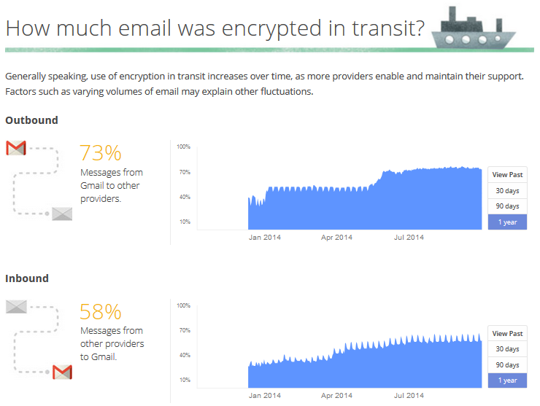
Sep 2016: 85%
Sep 2016: 75%

Slide 6

46.43%
Initial page over HTTPS
Source: April King, https://marumari.github.io/letsencrypt-overview/

Slide 7
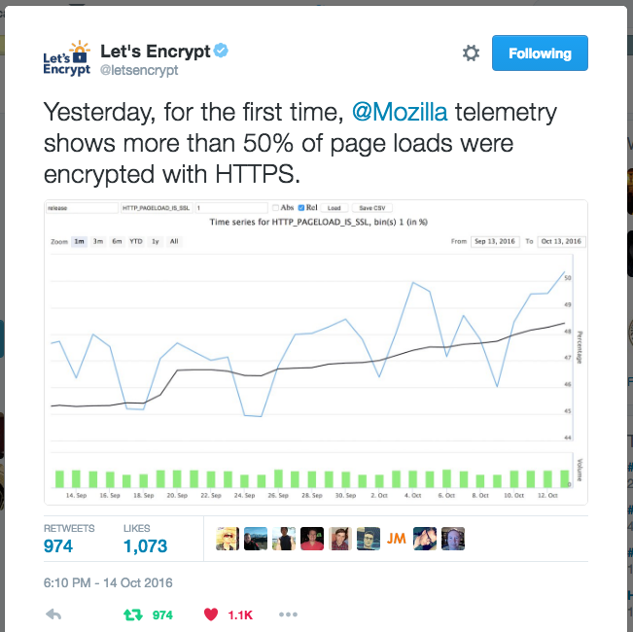

Slide 8

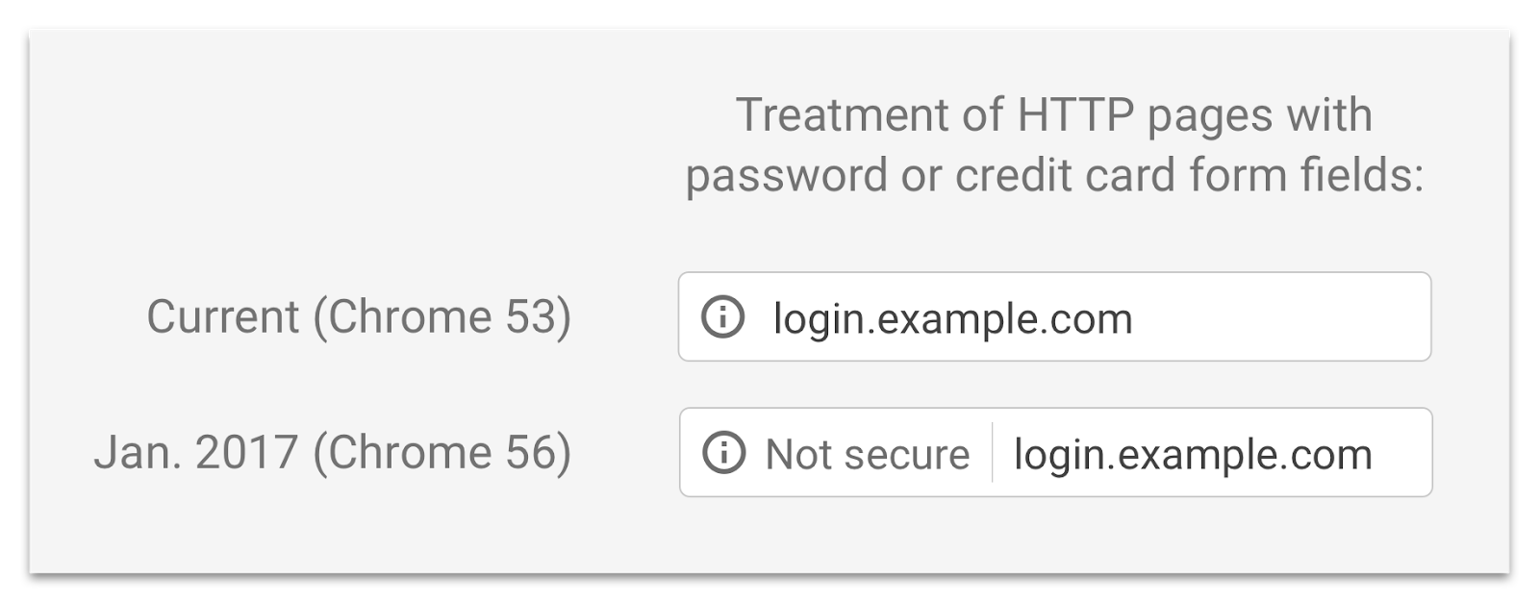
Google Chrome

Slide 9


Slide 10
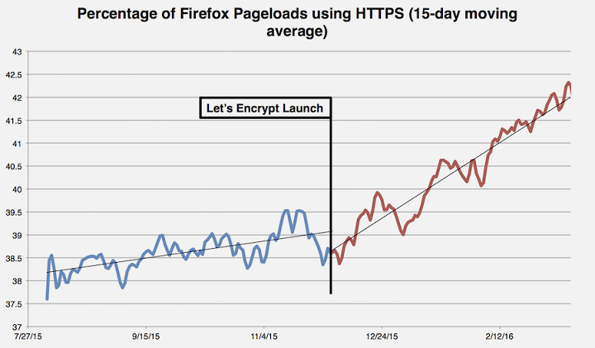

Slide 11
TLS 1.3
  Complete overhaul
  Removes cruft
  Improves performance
  New protocol for the
  next 20+ years

Slide 12
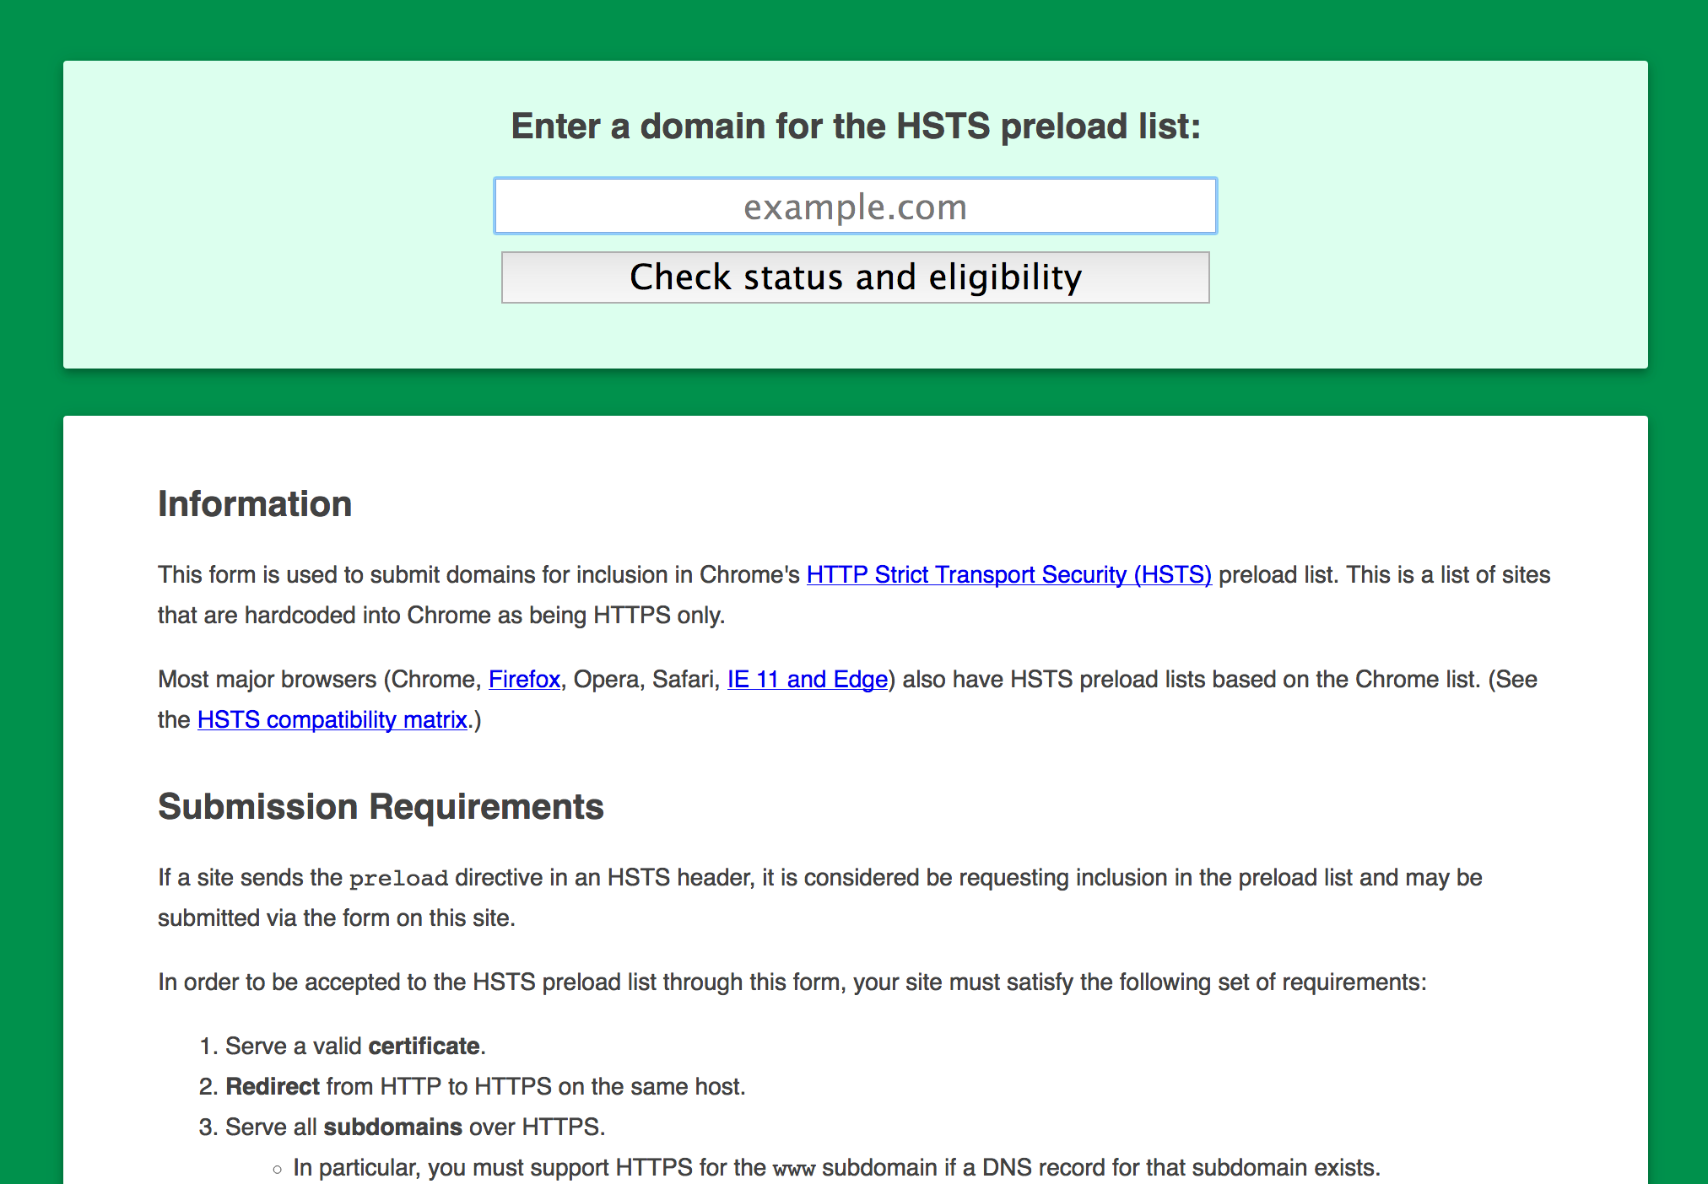
HTTP Strict Transport Security
    Strict-Transport-Security:
    max-age=31536000; includeSubDomains; preload
hstspreload.appspot.com

Slide 13
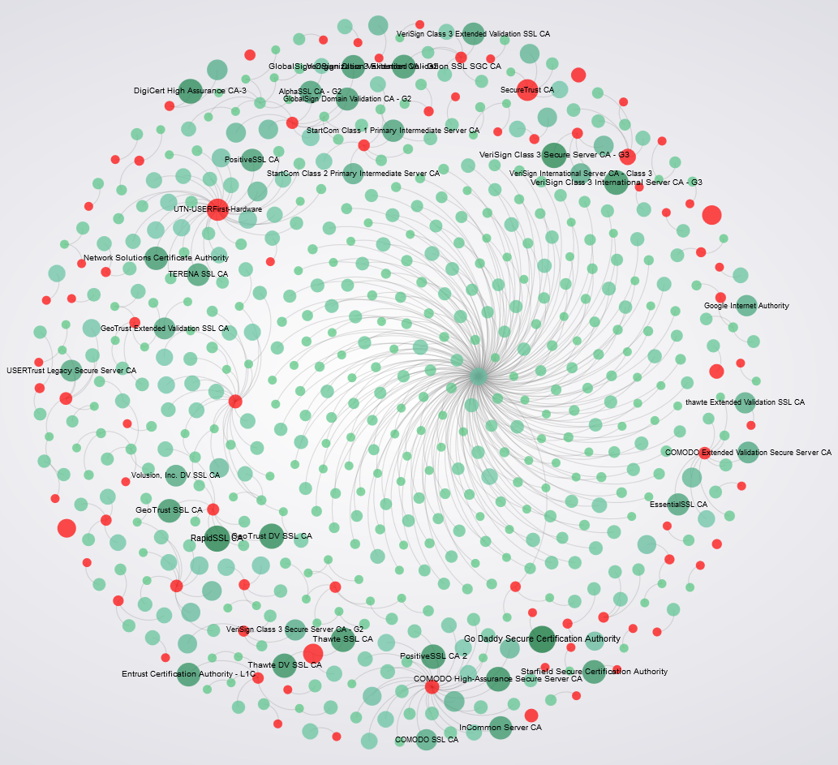
HTTP Public Key Pinning
Public-Key-Pins:
max-age=2592000; pin-sha256=“HASH"; pin-sha256="HASH"

Slide 14

Revocation doesn’t work.
Must-staple certificates to the rescue!

Slide 15

Certification Authority Authorization (CAA)
New DNS RR type (257) that
specifies which CA is allowed to issue certificates for your domain name.
example.org. CAA 1 issue "letsencrypt.org"

Slide 16

DNSSEC & DANE
Source: CloudFlare
Love/Hate

Slide 17

Content Security Policy
Source: http://www.messynessychic.com/2015/07/17/colombias-beloved-jeeps-loaded-with-everything-but-the-kitchen-sink/

Slide 18
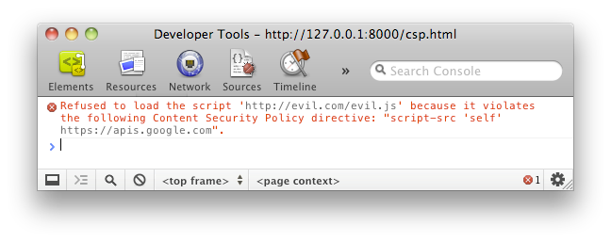
Content Security Policy
Restrict inline script,
styles, and eval()
Restrict resource loading
Restrict framing
Prevent mixed content

Slide 19
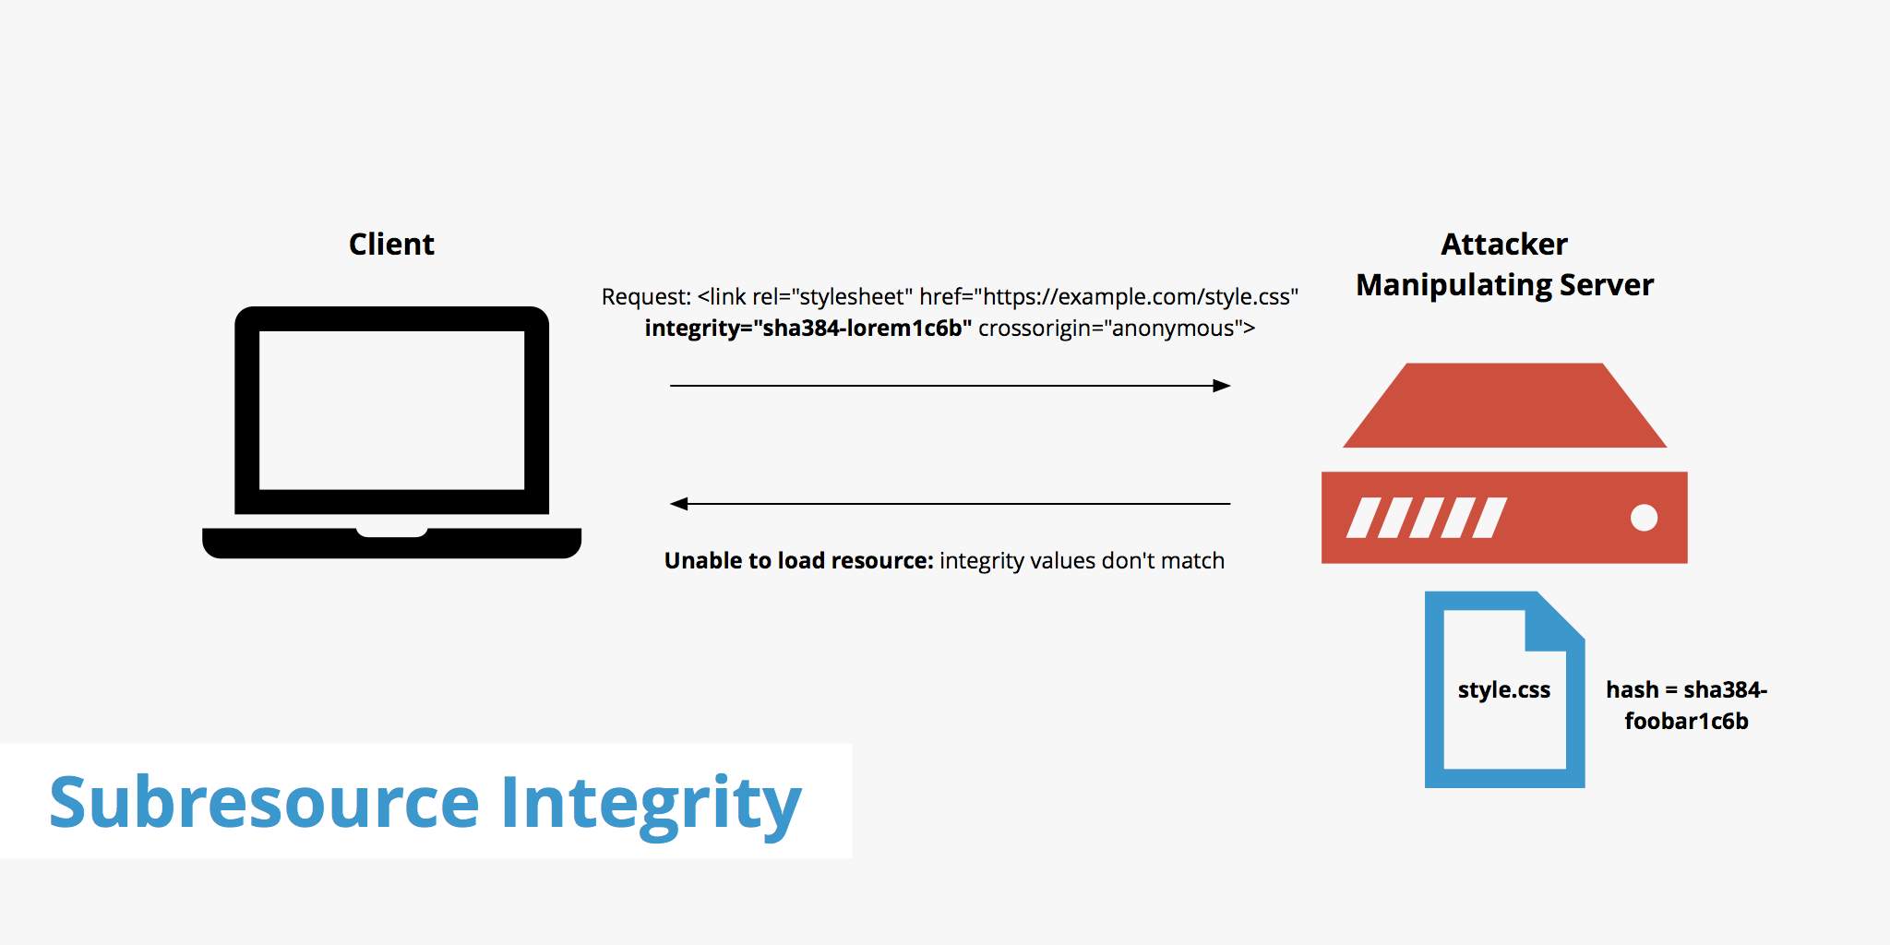
Subresource Integrity
Source: https://www.keycdn.com/support/subresource-integrity/

Slide 20
Subresource Integrity
<script
src=”//cdn.example.com/jquery.min.js”
crossorigin=”anonymous”
integrity=“sha256-[hash]”>
</script>

Slide 21
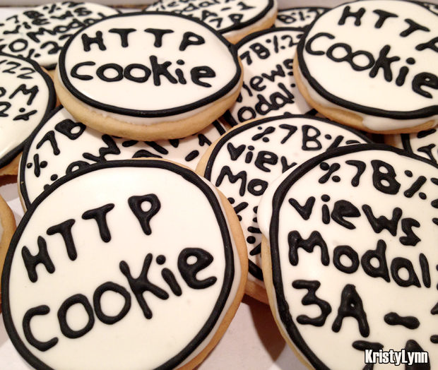
Same-site cookies
Cookie prefixes
__Host-
__Secure-
SameSite=Strict
SameSite=Lax

Slide 22
A few things I didn’t have time to talk about…
  CORS/ACAO
  XCTO
  XFO
  XDO
  XXP
  SPF
  DKIM
  DMARC
  SMTP STS
  Mixed-Content

Slide 24
How do we solve this?
Let’s take a look

Slide 25
Hardenize
Continuous monitoring and assessment

Slide 26
Less than 1% of top web sites use modern security features

Slide 27
WHOIS, DNS, DNSSEC, DANE, CAA, SMTP, STARTTLS, CAs, X.509, SPF, DKIM, DMARC, IPv4, IPv6, HTTP/2, SSL, TLS, HSTS, CSP, HPKP, RC4, SHA, Cookies, Mixed content, SRI,
Privacy, and many more…

Slide 28
The future [of security] is already here, but it’s not evenly distributed yet
William Gibson, adapted

Slide 29
Make security easy and fun!

Slide 30
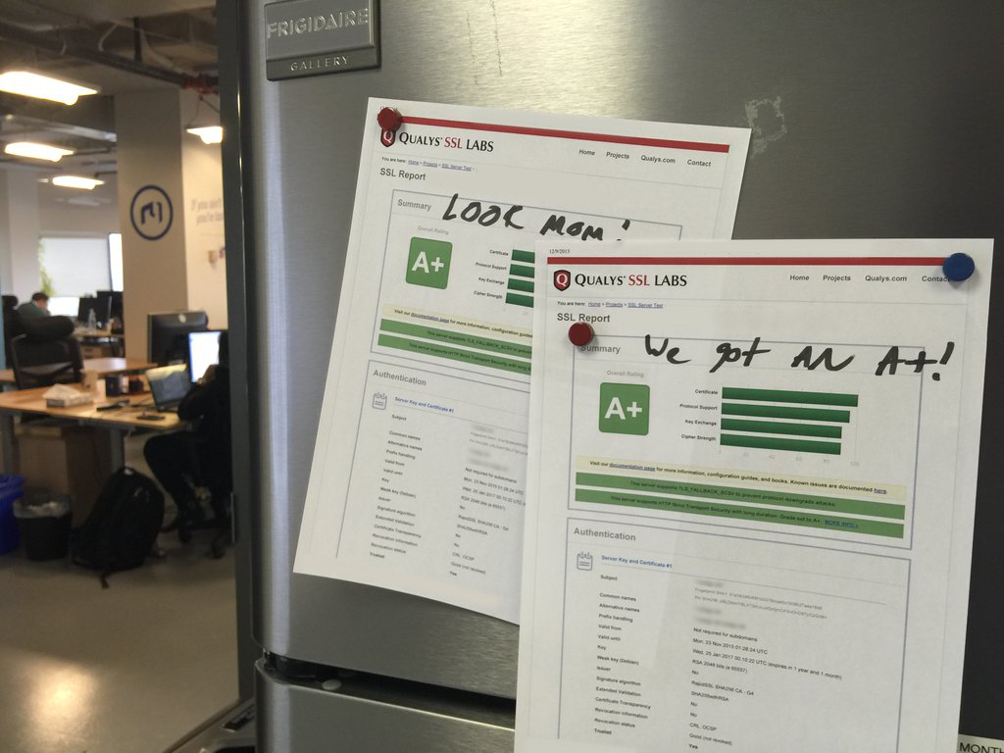

Slide 31
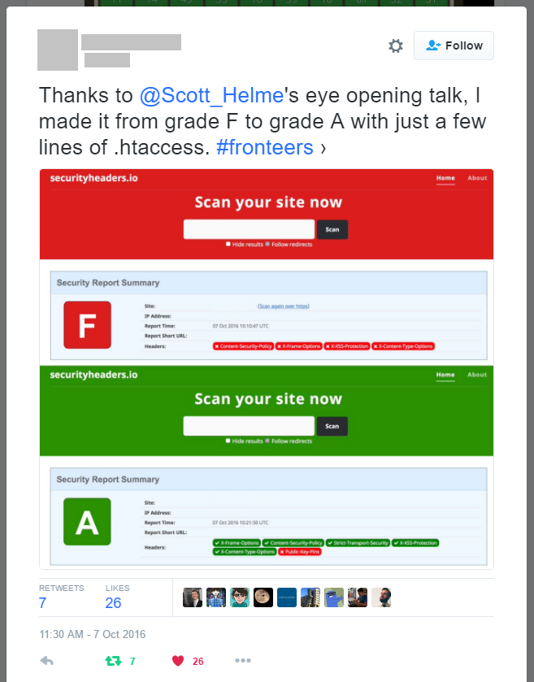

Slide 32
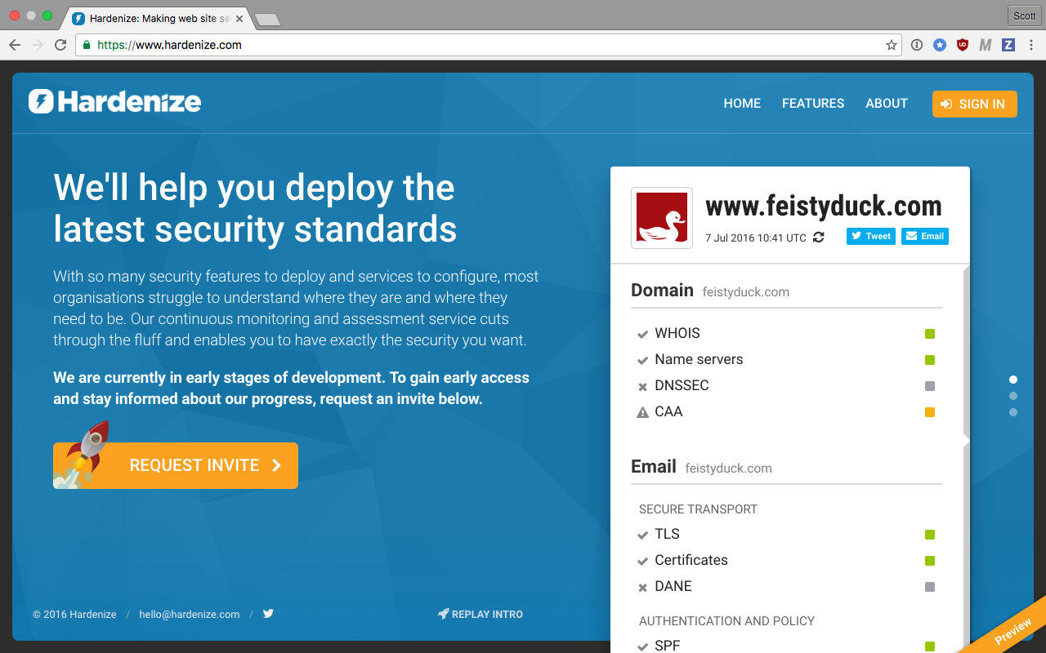

Slide 33
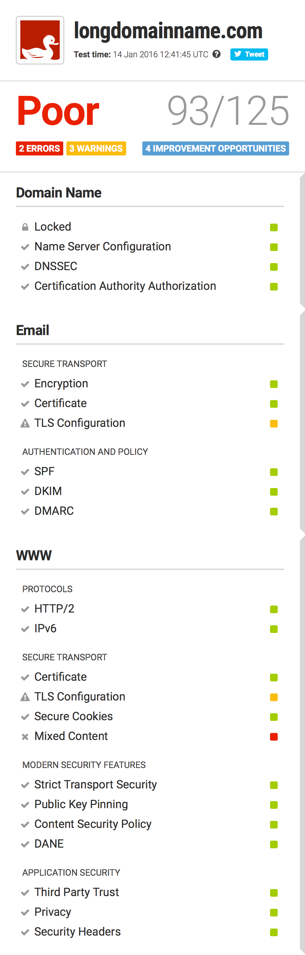
Easy to understand and communicate
The report is broken down to show key areas

Slide 34
Deceptively simple
More detail available on demand
Hundreds of complex tests under the hood

Slide 37

www.hardenize.com

