Slide 1

Resilient Software Engineering
Swiss Cyber Storm - Lucerne Switzerland - 2016-10-19
Nick Galbreath nickg@signalsciences.com

Slide 2
It’s Online!
https://speakerdeck.com/ngalbreath
resilient-software-engineering
I’m Online!
@ngalbreath

Slide 3
Context And Disclosure
Software engineering background
Web application background
I’m a vendor, but this is not a vendor talk.

Slide 4
100-10-1
Dev-Ops-Sec
👨👨👨👨👨👨👨👨👨👨
👨👨👨👨👨👨👨👨👨👨
👨👨👨👨👨👨👨👨👨👨
👨👨👨👨👨👨👨👨👨👨 👨👨👨👨👨
👨👨👨👨👨👨👨👨👨👨 👨👨👨👨👨 😱

Slide 5
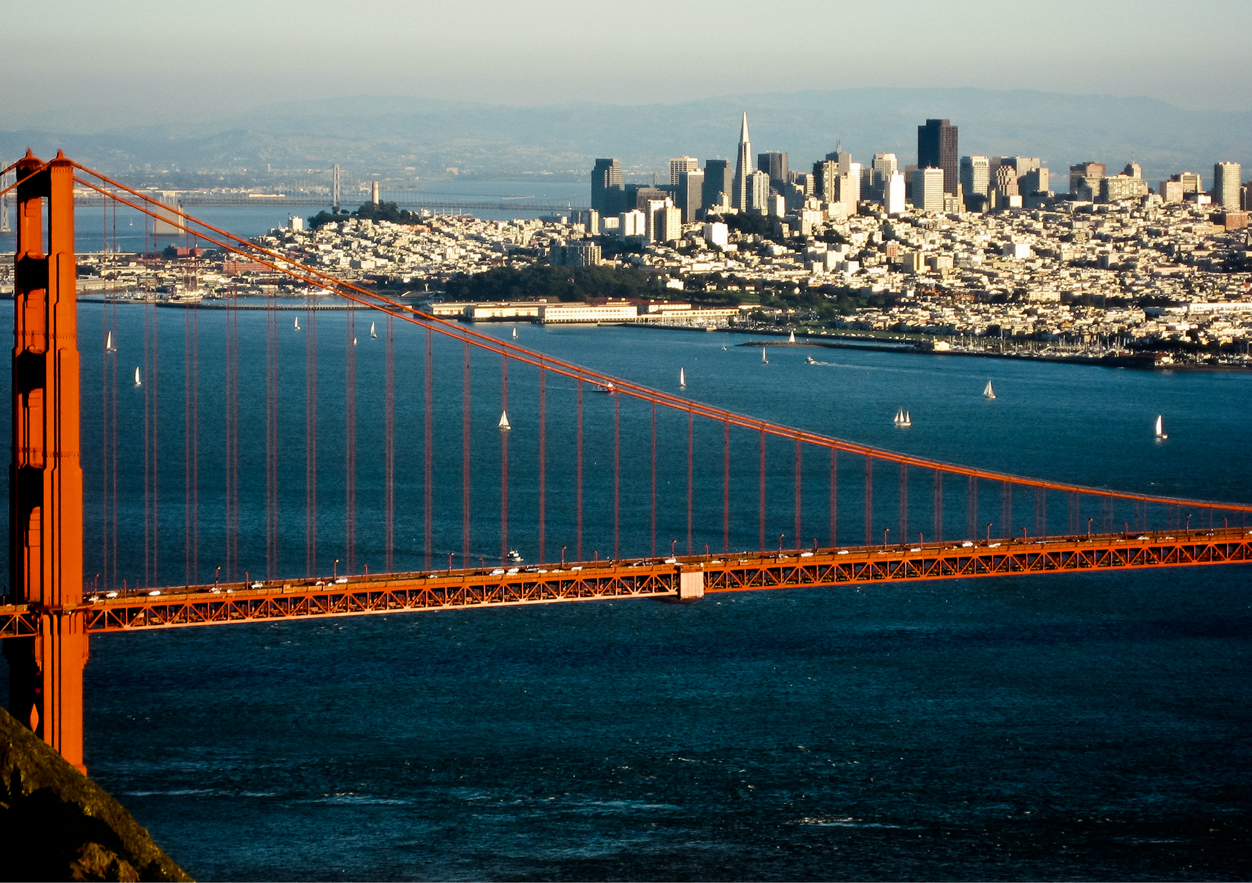
For every 1 person in infosec, there are 2 job postings
SF Bay Area

Slide 6
100-10-3
Dev-Ops-Sec
👨👨👨👨👨👨👨👨👨👨
👨👨👨👨👨👨👨👨👨👨
👨👨👨👨👨👨👨👨👨👨
👨👨👨👨👨👨👨👨👨👨 👨👨👨👨👨 😱
👨👨👨👨👨👨👨👨👨👨 👨👨👨👨👨 😱😱

Slide 7
Can We Turn
Security Problems into Engineering Problems?
100x Increase in Resources

Slide 8
Not Your Code
Your Code
Getting Your Code To Production
Monitoring Your Code
When Your Code Fails

Slide 9
Not Your Code

Slide 10
Your Application is 75% Open Source Software

Slide 11
Fact Check
$ find vendor -name '*.go' | xargs cat | wc -l
116324
$ find . -name '*.go' | xargs cat | wc -l
149496
$ dc 116324.0 149496.0 div 100 mul p
77.8108
$ find vendor -name '*.go' | xargs cat | wc -l
505970
$ find . -name '*.go' | xargs cat | wc -l
646517
$ dc 505970 646517 div 100 mul p
78.2609

Slide 12
Oh did I Include Linked C Libraries?

Slide 13
Which ruby/python/node/php modules require C libraries?

Slide 14
Where did this come from?
The OS ?
The Ops Team building an image ?
The Dev Team building a container or just vendoring / copying code?

Slide 15
Is It Up To Date?
If you are not using OS provided packages, how do you know?
If you are using the OS provided packages, staying to date is great, but..

Slide 16
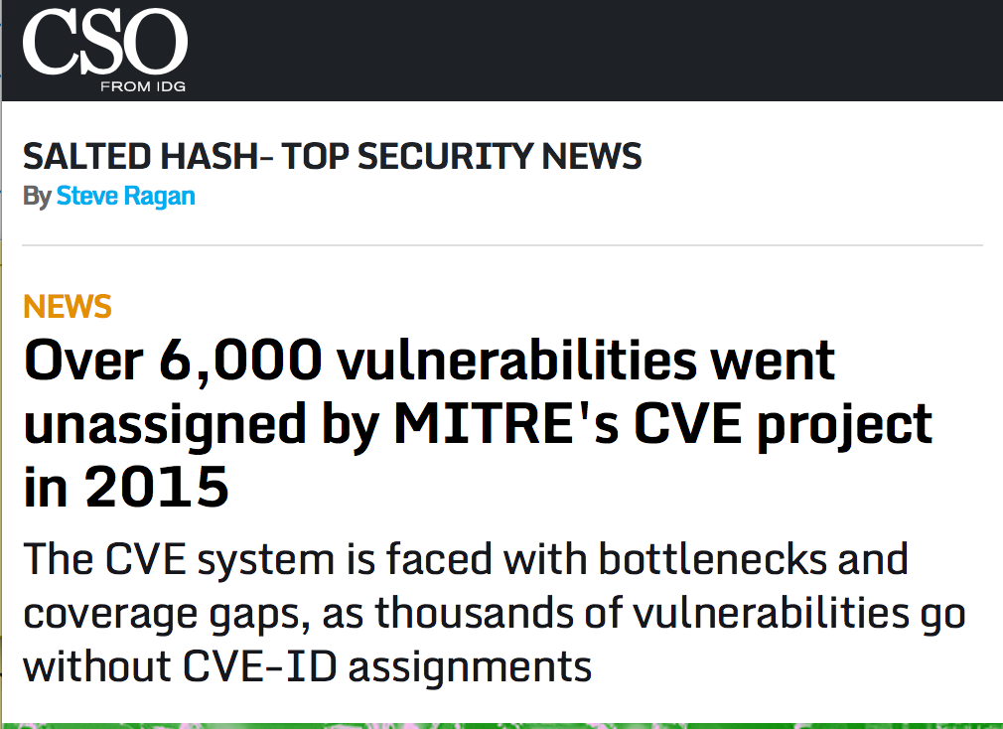
2016-10-22 http://www.csoonline.com/article/3122460/techology-business/over-6000-vulnerabilities-went-unassigned-by-mitres-cve-project-in-2015.amp.html

Slide 17
How is 3rd Party Software Managed?

Slide 18
The Software
Supply Chain is a Security Issue

Slide 19
Your Code

Slide 20
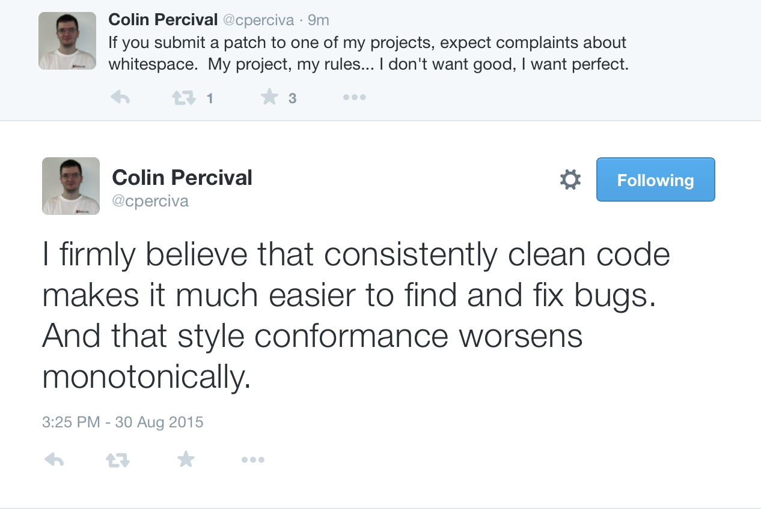

Slide 21
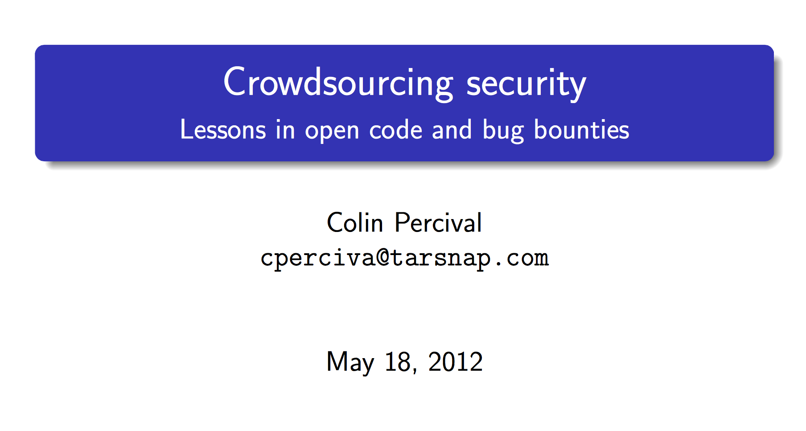
https://www.bsdcan.org/2012/schedule/attachments/218_crowdsec.pdf

Slide 22
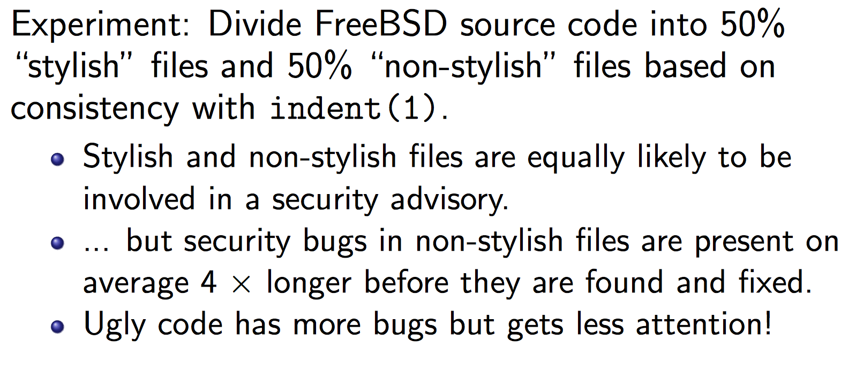
The Buried Lead:
4x Faster Bug Fixes

Slide 23
Oddly relevant to software

Slide 24
Sound Familiar?
16. Be clear…. Even to a writer who is being intentionally obscure or wild of tongue we can say, "Be obscure clearly! Be wild of tongue in a way we can understand!"
19. Do not take shortcuts at the cost of clarity. Many shortcuts are self-defeating; they waste the reader's time instead of conserving it.
20. Avoid foreign languages. (write in the standard language, reuse existing dependencies)
21. Prefer the standard to the offbeat. Young writers will be drawn at every turn toward eccentricities in language.

Slide 25
OpenSSL Heartbleed
Absolutely convinced this was due to the un-friendly un-styled code base

Slide 26
LibreSSL - The First 30 Days
KNF - Kernel Normal Form C-style
http://www.openbsd.org/papers/bsdcan14-libressl/
May 18, 2014

Slide 27
BoringSSL
First thing mentioned? Style cleanup
So BoringSSL headers and sources look like this rather than this. The comments in BoringSSL headers can be extracted by a tool to produce documentation of a sort. (Although it could do with a make-over.)
(Clang's formatting tool and its Vim integration are very helpful! It's been the biggest improvement in my code-editing experience in many years.)
https://www.imperialviolet.org/2015/10/17/boringssl.html

Slide 28
Attackers Know This Too
How I Hacked Facebook, and Found Someone's Backdoor Script
Orange Tsai http://blog.orange.tw
… But from the fragments of source code mentioned in the Advisory, I felt that with such coding style there should still be security issues remained in FTA if I kept looking. Therefore, I began to look for 0-Day vulnerabilities on FTA products! …. finds 7 CVEs
http://devco.re/blog/2016/04/21/how-I-hacked-facebook-and-found-someones-backdoor-script-eng-ver/

Slide 29
The Canonical Example, With C and PHP
if (something)
do_critical();

Slide 30
      > log_debug(…);

Slide 31
if (something)
    log_debug(…);
    do_critical();

Slide 32
if (something)
      log_debug(…);
do_critical();

Slide 33
if (something) do_critical();

Slide 34
<-if (something) do_critical();
>+if (something) {
>+ log_debug("…");
>+ do_critical();
>+}

Slide 35
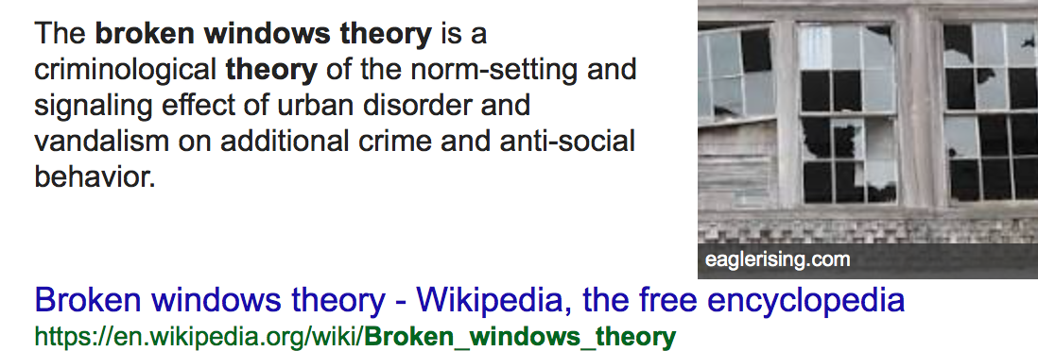
Lots of asterisks here. Low Data Quality,
Cause != Correlation
Type of Crime or Severity not well measured.
Read on!: http://cebcp.org/.../broken-windows-policing/

Slide 36
Only applies to accidents that scale linearly in severity
… major failures have much more complex causes

Slide 37
Results
Faster code reviews
More code reviews
Smaller diffs
Less merge conflicts
Faster bug detection
Faster on boarding
Side effect: simpler code.
Easier to read for everyone, including security reviews.

Slide 38
Software Safety issues are Security Issues

Slide 39
Getting Your Code To Production

Slide 40
Every engineering organization in the world is trying to go faster by using cloud, devops, continuous integration, agile
Or Planning To Do So, With Some Projects

Slide 41
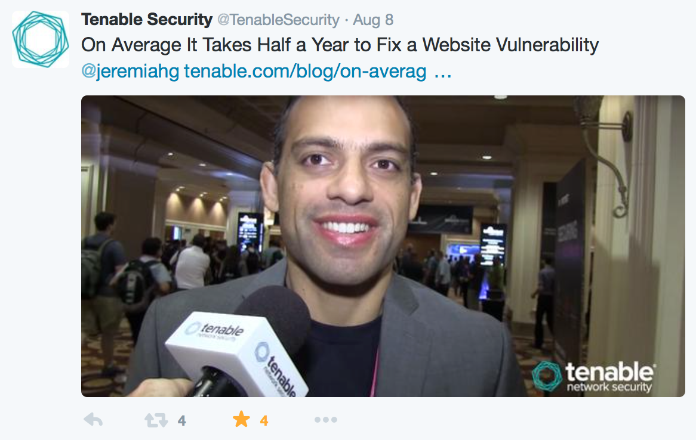
Average time to fix a vulnerability is 150 days after being reported…. you think that is due to technical reasons?

Slide 42
TL;DR on Continuous Deployment

Slide 43

Security can make
patches as needed
or
Require developers to do
so in a timely manner

Slide 45
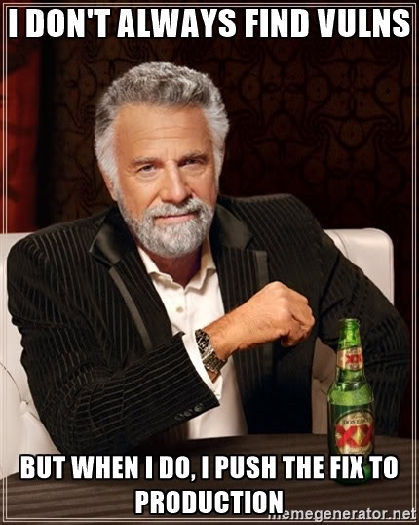

Slide 46

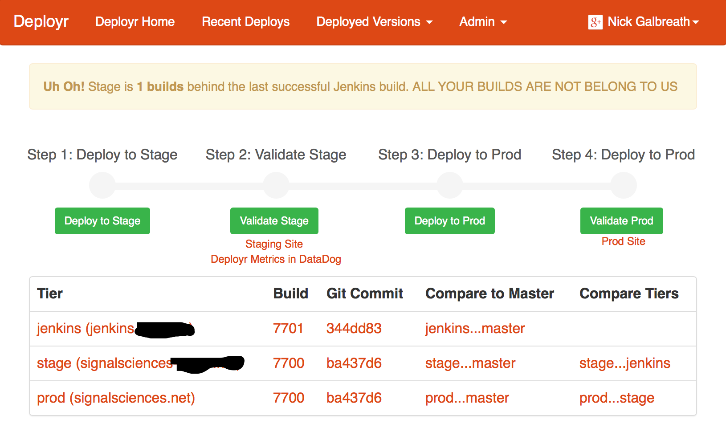
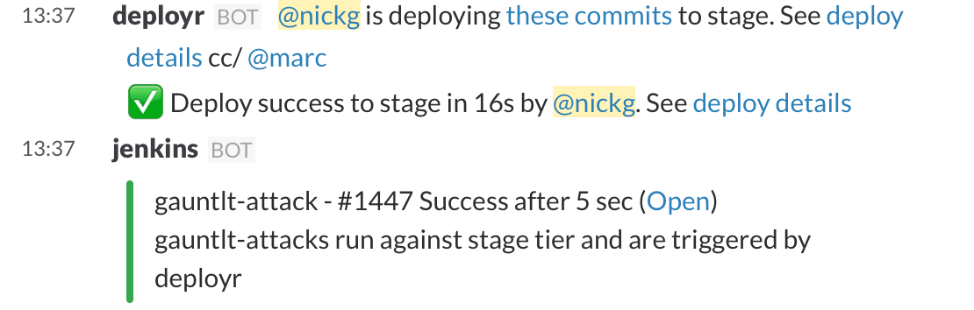
Formatting Checks
Linting
Static Analysis
Security Checks
Unit Tests
Integration Tests
Spelling Checks
Login / Auth

Slide 47
How Code is Deployed is an Security Issue

Slide 48
Monitoring
Your Code

Slide 49
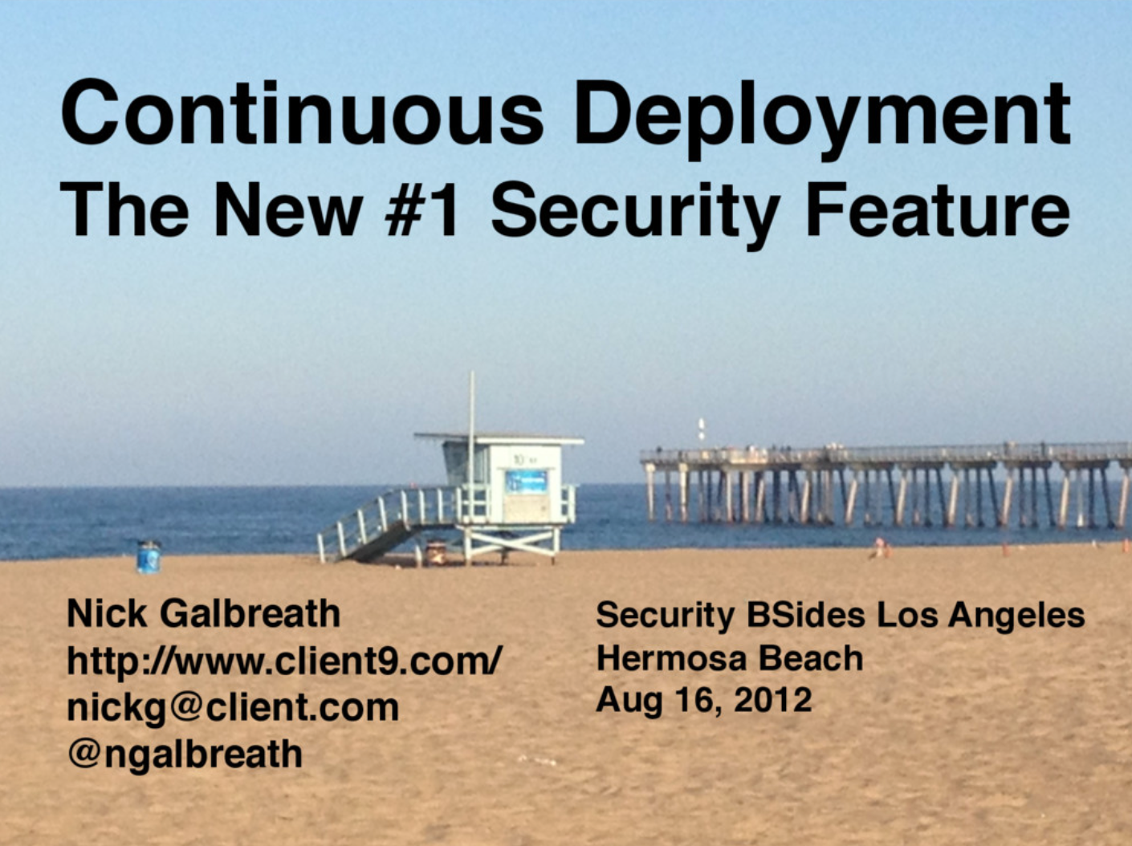
https://speakerdeck.com/ngalbreath/continuous-deployment-1

Slide 50
No, that’s not going to work
https://www.nps.gov/media/photo/gallery.htm?id=F865DA8A-155D-4519-3E66BBFECC74C707

Slide 51
Continuous Deployment Doesn't Change This Fact
👨👨👨👨👨👨👨👨👨👨
👨👨👨👨👨👨👨👨👨👨
👨👨👨👨👨👨👨👨👨👨
👨👨👨👨👨👨👨👨👨👨 👨👨👨👨👨
👨👨👨👨👨👨👨👨👨👨 👨👨👨👨👨 😱

Slide 52
<vendor>
Very old screenshots

Slide 53
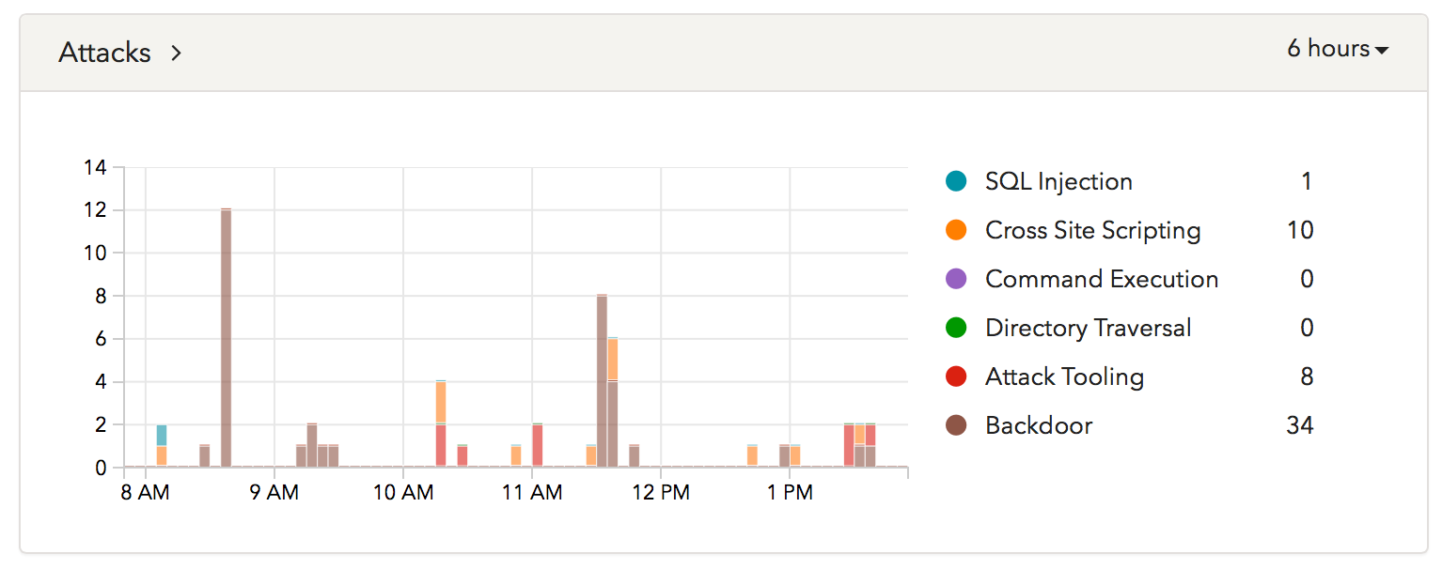
Cosmic Background Noise of Attacks

Slide 54
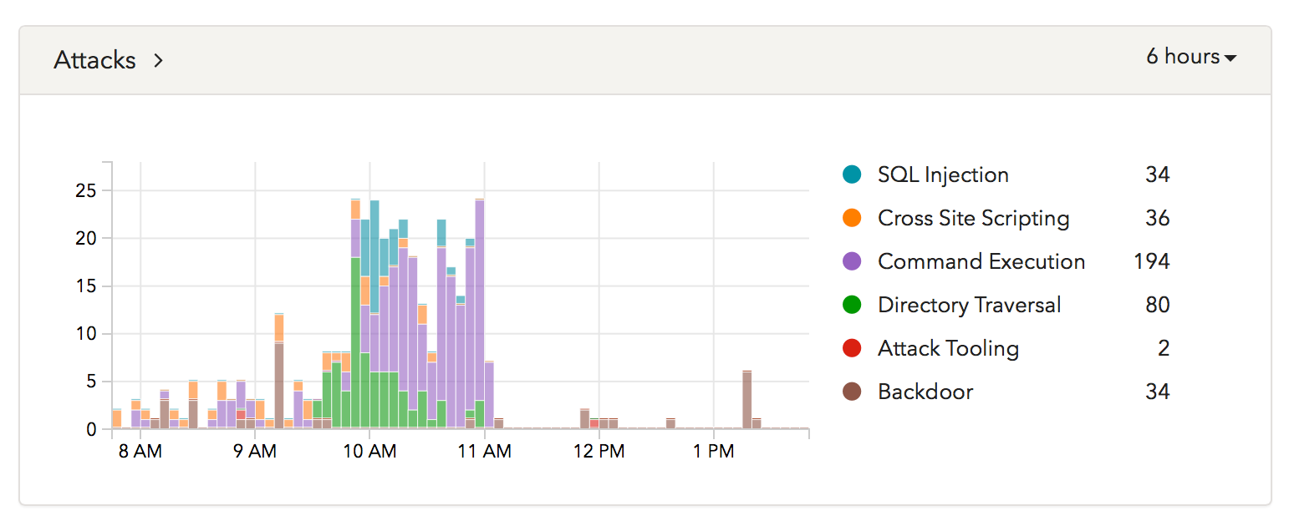
Cloud-based scanner

Slide 55
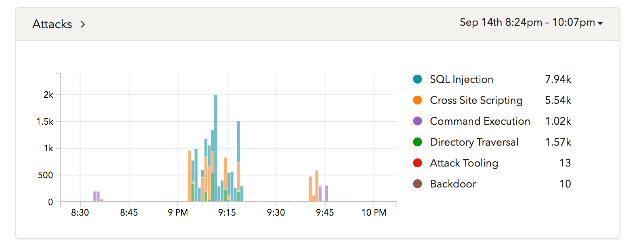
Attack Tooling

Slide 56
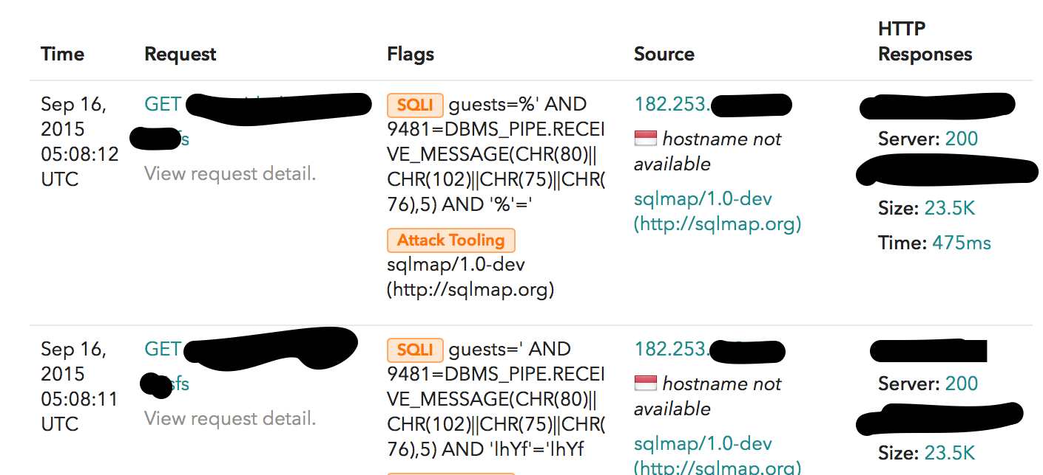
Using SQLMap, on this URL, focused on 'guests'

Slide 57
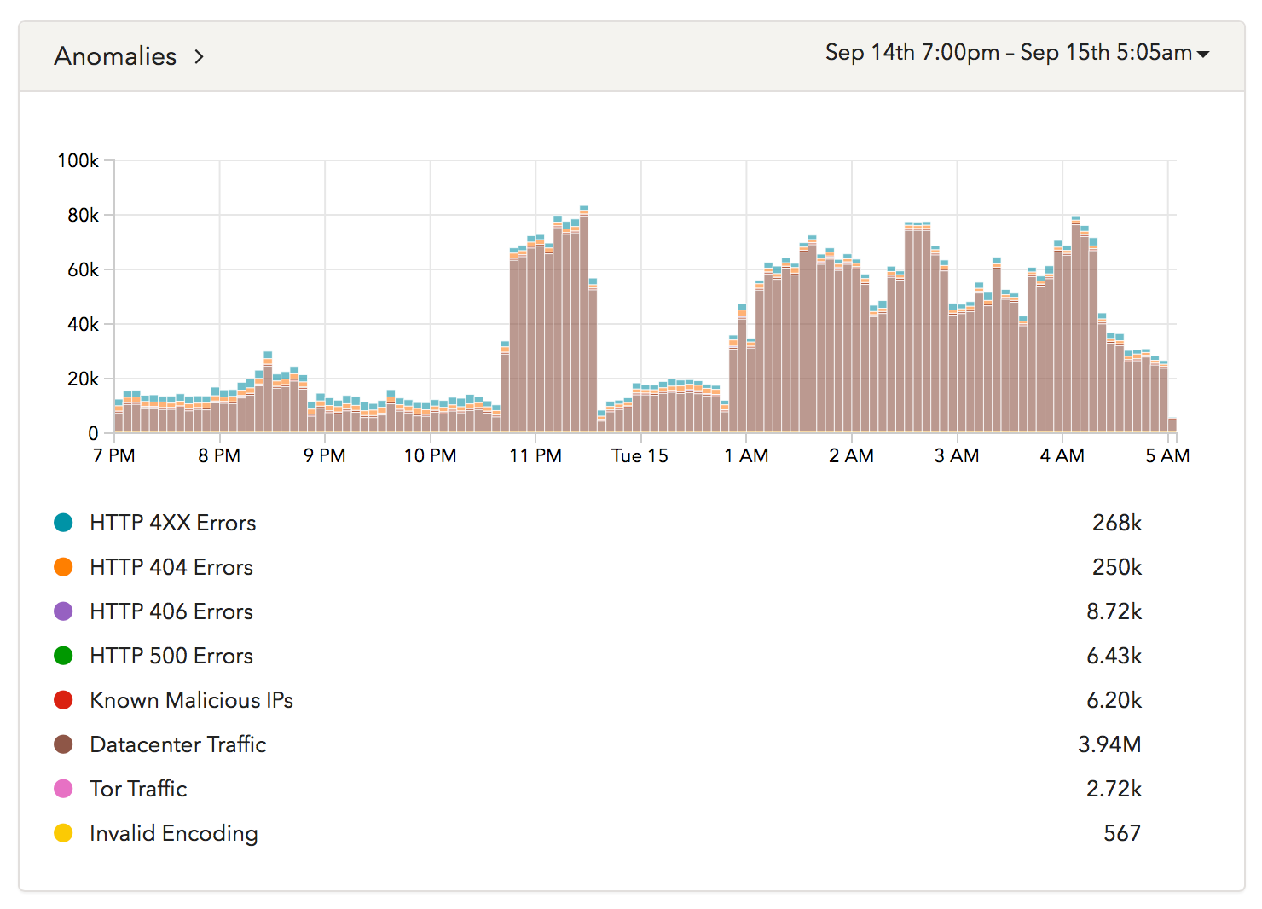

Slide 58
</vendor>

Slide 59
Most Developers Have Never Seen An Actual Attack on Their Code.
Any code.

Slide 60
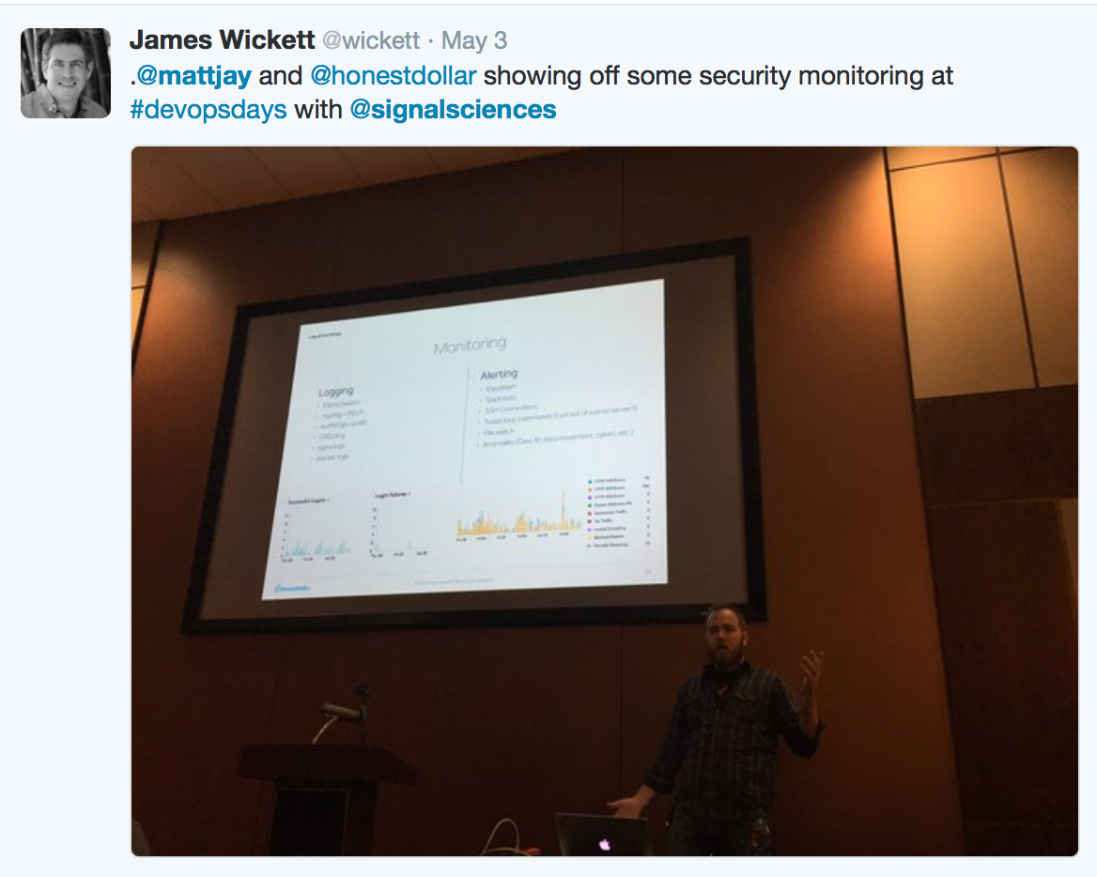
It Changes Things

Slide 61
Realtime
Application Monitoring is a
Security Issue

Slide 62
When Your Code
Fails

Slide 63
Breach Happens

Slide 64
Email

Slide 65
You Never Send Email to All Your Customers
Marketing emails are done by another group/system, and have opt-outs. Might even have non customers in the list.
Billing emails are staggered, and done by different group. And only if they have a bill.
Other notifications are done “on demand” in real-time.

Slide 66
Let’s Do The Math
Using your API gateway, maybe you are sending 1 email per second.
That is ~12 days per million customers.

Slide 67
Assuming
You can get the email list in the first place
That your API provider doesn’t rate limit you due to massive change in volume
That the email provider isn’t marking everything as spam.
That your website doesn’t crash based on increase in logins due to your email.
That your email sending process isn’t interrupted
(need to mark who got an email)

Slide 68
Really?
Ok, it’s unlikely Engineering is going to reprioritize the email stack just for this.
But what is the IR plan?
Does Engineering understand what it means?
What is going to be the impact on CI?

Slide 69
Operational Infrastructure is a Security Issue.

Slide 70
Summary

Slide 71
These are Security Issues
Where software comes from
How software is written
How software is deployed
How software is monitored
Software performance

Slide 72
Every Item Mentioned Makes Engineering Better.
And more secure.

Slide 73
Start the Dialog

Slide 74
Can we make AppSec look more like this?
👨👨👨😱👨👨👨👨👨👨
👨👨👨👨👨👨👨👨😱👨
👨😱👨👨👨👨👨👨👨👨
👨👨👨👨👨😱👨👨👨👨 😱👨👨👨👨
👨👨👨👨👨👨👨👨👨👨 👨👨😱👨👨 😱

Slide 75
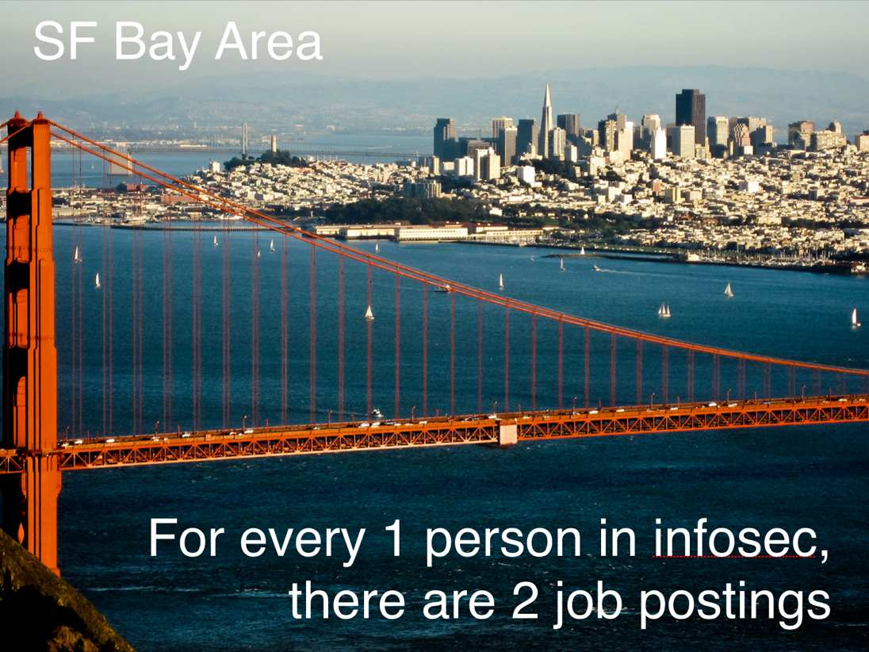
Can’t Make an Impact?
0% Unemployment

Slide 76
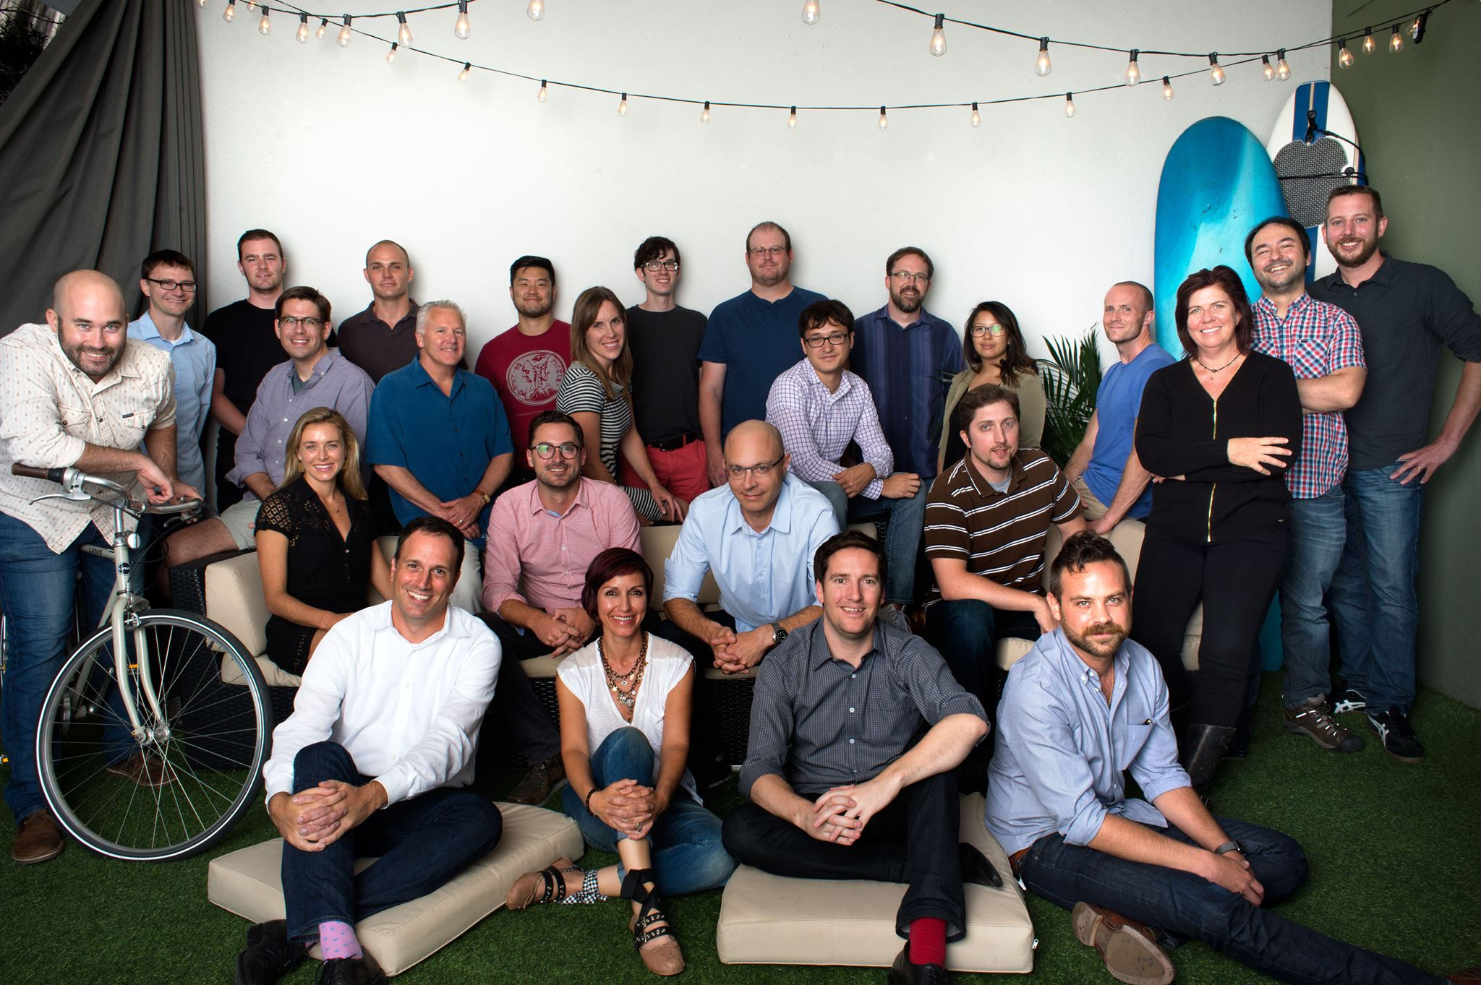
nickg@signalsciences.com

